Slide 1





TRANSFORMER LESS GRID TIE PHOTOVOLTAIC INVERTER USING DUAL-STAGE BOOST AND BUCK CONVERTERS
Under the Guidance of
Dr .Sathish K R ME ,Ph.D.
Assistant professor
Department of EEE
ATMECE
Final Year Seminar presentation
Presented By:
Madhu Gowda H K:4AD18EE015
Department of Electrical and Electronics Engineering,
ATMCE , Mysuru.

Slide 2
INTRODUCTION
CONTENTS
LITREATURE SURVEY
CASESTUDY
ADAVANTAGES
2
2
CONCLUSION
REFERENCES
Department of Electrical and Electronics Engineering, ATMECE, Mysuru

Slide 3

INTRODUCTION
GRID TIE INVERTER:
It is a special type of inverter that is used in a renewable energy power system to convert direct current into alternating current and feed it into the utility grid
In photovoltaic (PV) system solar energy is converted into electrical energy through PV arrays .There are two mandatory tasks in PV system. They are utilizing maximum energy from PV arrays, using the most reliable, highly efficient and cost effective configuration for the power converter in order to inject only active current into the grid
Department of electrical and electronics engineering
ATMECE,MYSURU

Slide 4
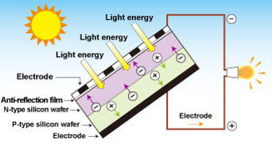
Basics of PV cell:
Photovoltaic cells consist of two or more layers of semiconductors with one layer containing positive charge and the other negative charge lined adjacent to each
PV cell generates a voltage around 0.5 to 0.8 volts depending on the semiconductor and the built up technology
To get the required voltage ,tens of PV cells are connected in series to form a PV module followed by interconnection in series or parallel
Department of electrical and electronics engineering
ATMECE , Mysuru

Slide 5
PHOTOVOLTAIC TECHNOLOGY:
PV system as an alternative energy resource
Complementary energy –resource in hybrid systems
Fast evolution , due to:
Development of fast semiconductor switches
Introduction of real time controllers
Necessary:
High reliability
High efficiency
Reasonable cost
Smaller size and weight
Department of electrical and electronics engineering
ATMECE , Mysuru

Slide 6
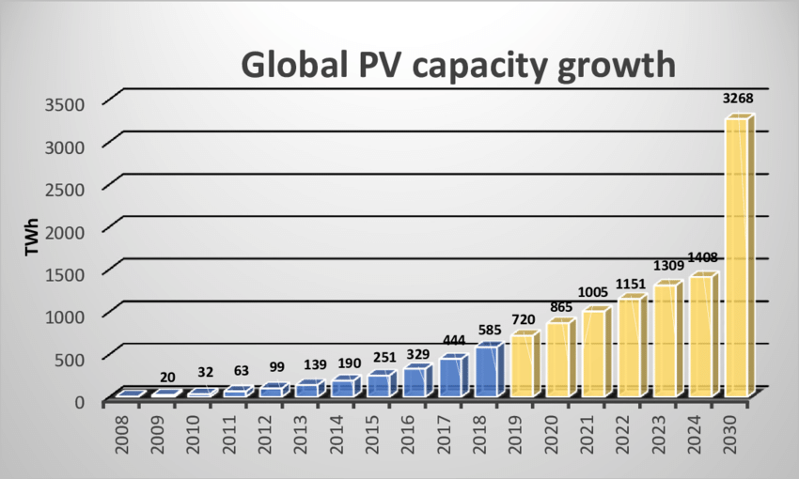
In the present global energy and environmental context, the aim of reducing the emissions of greenhouse gases and polluting substances
New strategies for the operation and management of the electricity grid
Department of electrical and electronics engineering
ATMECE,MYSURU

Slide 7
transformer less GTI
PV array
Dual stage dc-dc boost converter
Dc to ac converter
Immitance conversion circuit
MPPT algorithm
grid
Dual- stage buck for inverter switching
Fig. Block diagram of transformer less GTI
Department of electrical and electronics engineering
ATMECE,MYSURU

Slide 8
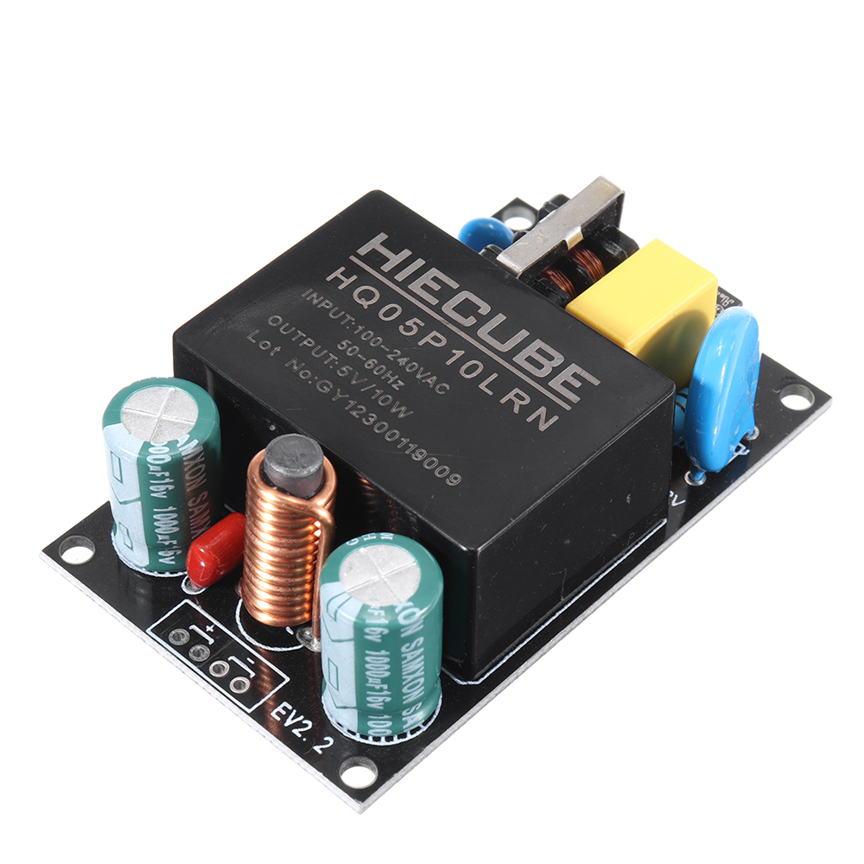
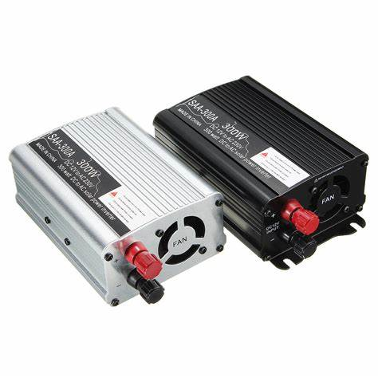
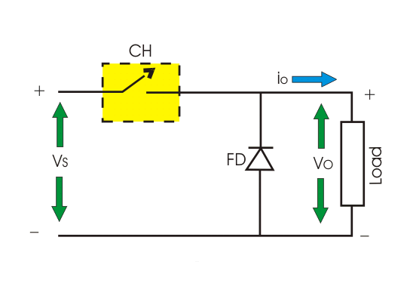
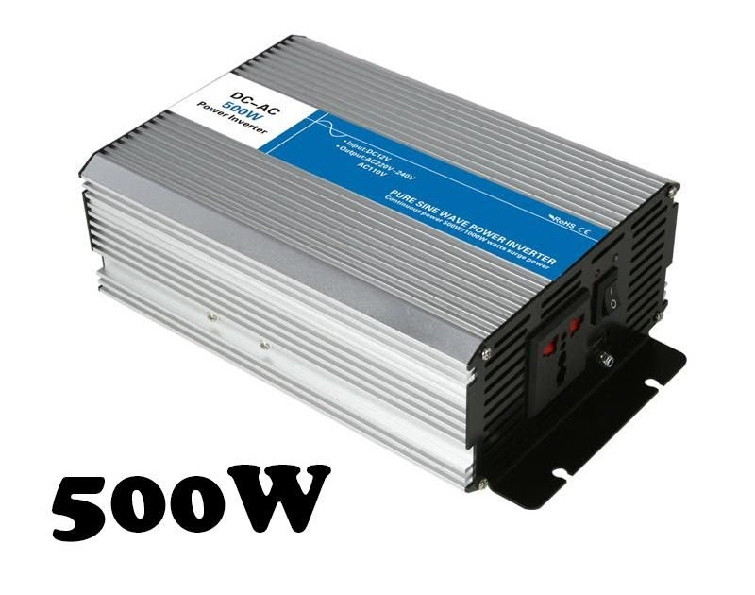
There are four basic conversion functions that normally can be implemented such as
AC to DC
AC to AC
DC to AC DC to DC
Inverter is one of the converter families which are called DC to AC converter. It converts DC power to AC power to a symmetric AC output voltage at desired magnitude and frequency .
Inverter is widely used in industrial applications such as variable speed AC motor drives, induction heating, standby power supplies and uninterruptible power supplies.
Department of electrical and electronics engineering
ATMECE,MYSURU

Slide 9
LITERATURE SURVEY
[1] In this paper, a comprehensive simulation of an implementation of three phase grid connection inverter is presented the control of structure of the grid side inverter is firstly discuss it secondly the space factor modulation SVM is presentedly the synchronisation of the grid connected
[2] The Maximum Power Point Tracker (MPPT) is the optimum operating point of a photovoltaic module. It plays a very important role to obtain the maximum power of a solar panel as it allows an optimal use of a photovoltaic system, regardless of irradiation and temperature variations
[3] This article evaluates the characteristics of the typical pi and t type configurations, for constant current output applications. The input -output characteristics and efficiency characteristics are analyzed experimentally.
[4] This paper present ,a grid tie inverter for photovoltaic ,PV application with a combination switching strategy of square wave and the sinusoidal pulse width modulation.
Department of electrical and electronics engineering
ATMECE , Mysuru

Slide 10
[5] A review of single-phase Grid Connected Inverters for Photovoltaic Modules. This review focuses on inverter technologies for connecting PV modules to a single phase grid
[6] In this paper ,it consists of two sets of PV array and buck boost type chopper circuit .however , the system has lower using rate of PV energy than that of the ordinary power system
[7] this paper present a buck –boost PWM inverter and its application for residential photovoltaic system . the PWM power inverter is realized by a driving a inverter constructed with a high frequency buck boost in discontinuous conduction mode.
[8] Power Electronics ,Circuits, Devices, and Applications
Department of electrical and electronics engineering
ATMECE , Mysuru

Slide 11
CASE STUDY:
Dual-stage DC-DC Boost converter:
A DC to DC converter is a type of power converters which converts a source of direct current (DC) from one voltage level to another by storing the input energy momentarily and then releasing that energy to the output at a different voltage.
The storage should be in electric field storage components or in magnetic field storage components.
DC-DC boost converter is used for converting unregulated voltage to a fixed level regulated voltage.
In the boost converter, a smoothing inductor is used in series with the input voltage to limit the current ripple of converter. In conventional processes, inductor value is normally chosen from the recommended data sheets. But here voltage conversion is occurred at a large scale
Department of electrical and electronics engineering
ATMECE , Mysuru

Slide 12
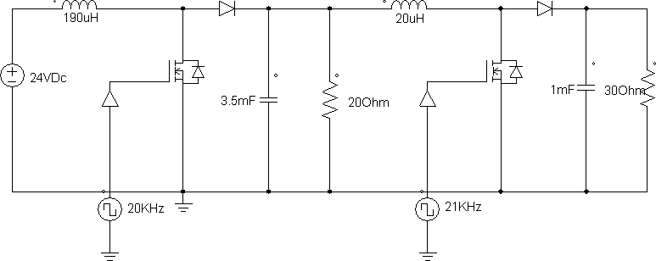
This power converter is controlled by Pulse Width Modulation (PWM) and applied through transistor
Dual-stage converter provides a more symmetrical duty cycle, and reduces the voltage stress on the MOSFETs.
a dual-stage (N=2) boost converter is proposed since the duty cycle of single-stage boost converter would be large (above 90%), which is not convenient for MOSFET switching.
Fig. Dual-stage Boost Power Converter
Department of electrical and electronics engineering
ATMECE , Mysuru

Slide 13
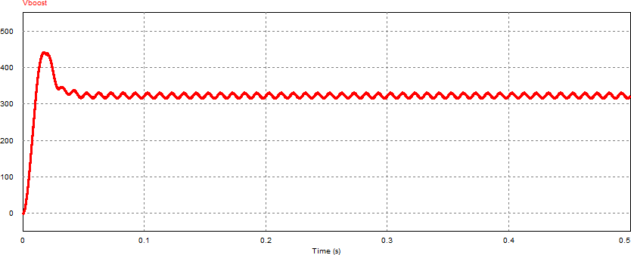
The boost converter is used for 24V-312V conversion and it is used instead of transformer.
Fig. Dual-stage Boost converter output
Department of electrical and electronics engineering
ATMECE , Mysuru

Slide 14
Design parameter of Boost Power Converter:
Boost is designed in two stages (N=2), compared to straight boost converting this technique provides a more symmetrical duty cycle and reduced voltage stress on the MOSFET.
Moreover in straight boost converter required duty cycle is tough to handle by switching.
therefore the conversion of boost converter is done based on conversion ratio which converted 24V DC to 86V DC then 86V DC to 312V DC.
Efficiency, size, and cost are the primary advantages of switching power converters when compared to linear converters. The switching power converter efficiencies can run between 70-80%, whereas linear converters are usually 30% efficient. The DC-DC Switching Boost Converter

Slide 15
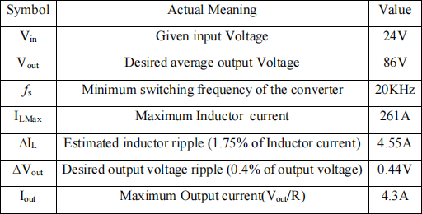
Design parameters of first stage Boost converter:
Department of electrical and electronics engineering
ATMECE , Mysuru

Slide 16
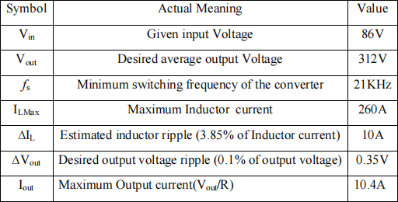
Design parameters of second stage Boost converter:
Department of electrical and electronics engineering
ATMECE , Mysuru

Slide 17
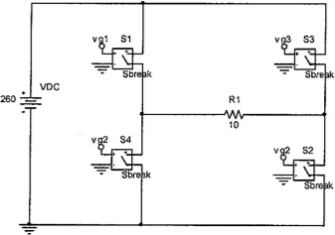
DC-AC Inverter:
Inverter is an electrical device that converts a direct current DC into an alternating current (AC).
The basic principle is to convert a DC into an AC is by controlling the electrical switching components. represents the basic inverter circuit with ideal switch.
Fig. Basic inverter circuit with ideal switch
Department of electrical and electronics engineering
ATMECE , Mysuru

Slide 18
Inverter Design Requirement:
The requirements for inverter go as follows:
Output Voltage Equal to 220 VRMS
Fixed Output Frequency of 50 Hz
Capable of Supplying Power up to 2500W
Maximum Load Current of 12 A
Input DC Voltage Between 24 V
Efficiency at Full Load Current Greater than 98%
Through Hole Soldering of the Integrated Circuits
Department of electrical and electronics engineering
ATMECE , Mysuru

Slide 19
Inverter Applications:
Everyday appliances such as microwaves, power tools, TVs and VCRs, lights, audio/visual equipment, battery chargers and computers are common loads.
Pure Sine Wave inverters are ideal for running sensitive test equipment such as communications equipment, oscilloscopes, scales, high end stereos & video equipment, communications equipment, etc.
The most useful use in renewable energy conversion such as to convert solar energy to electrical energy
Inverters can be used as an UPS-Uninterruptible power supplies
These can be used in centrifugal fans , pumps , mixers , test stands , metering pumps and web –handling equipment .
Department of electrical and electronics engineering
ATMECE , Mysuru

Slide 20
ADVANTAGES
Solar energy is environmentally friendly.
Solar panel has no moving part.
Low cost and compact in size.
Smaller weight , size and better efficiency.
High voltage gain and the problem of common mode leakage current is eliminated.
Department of electrical and electronics engineering
ATMECE , Mysuru

Slide 21
DISADAVNTAGES
Transformer less inverters adopt switch mode technique to convert From dc to high frequency ac.
Dc and ac circuits are not electrically isolated in transformer less inverters and are exposed to lightning protection concerns.
Faults in transformer less inverters are usually lethal with severe damage.
Department of electrical and electronics engineering
ATMECE , Mysuru

Slide 22
CONCLUSION
Power-electronic technology plays a very important role in the field of renewable energy sources
Optimize the energy conversion and transmission
Minimize harmonic distortion and leakage current
To achieve at a low cost a high efficiency over a wide power range
Achieve a high reliability
The trend of the PV energy leads to consider that it will be an interesting alternative in the near future
Department of electrical and electronics engineering
ATMECE , Mysuru

Slide 23
REFERANCES
[1] Ahmed Abdalrahman, Abdalhalim Zekry, and Ahmed Alshazly, “Simulation and Implementation of Grid-connected Inverters”, International Journal of Computer Applications (0975 – 8887) Volume 60– No.4, December 2012.
[2] Hairul Nissah Zainudin and Saad Mekhilef, “Comparison Study of Maximum Power Point Tracker Techniques for PV Systems”, Proceedings of the 14th International Middle East Power Systems Conference (MEPCON’10), Cairo University, Egypt, December 19-21, 2010, Paper ID 278.
[3] T. K. Kwang, S. Masri, “Single phase grid tie inverter for photovoltaic application,” Proc. IEEE Sustainable Utilization and Development in Engineering and Technology Conf., pp. 23-28. Nov 2010.
[4] A. S. K. Chowdhury and M. A. Razzak, "A Combined π- and T-type Immittance Converter for Constant Current Applications", Proceedings of the IEEE International Conference on Informatics, Electronics & Vision (ICIEV), May 17- 18, 2013, Dhaka Bangladesh.
Department of electrical and electronics engineering
ATMECE , Mysuru

Slide 24
[5] Marco Liserre, Frede Blaabjerg, Steffan Hansen, “Design and Control of an LCLFilter-Based Three-Phase Active Rectifier”. S.L IEEE Transactions on Industry Applications, September/October 2005. pp. VOL. 41, NO. 5
[6] S. B. Kjaer, J. K. Pedersen, and F. Blaabjerg, “A review of single-phase GridConnected Inverters for Photovoltaic Modules,” IEEE Transactions on Industry Applications, vol. 41, pp. 1292-1306, September/October 2005
[7] N.Kasa & t.Iida “ A Transformer-less Single Phase Inverter using a Buck-Boost type Chopper Circuit for Photovoltaic Power System” Proceeding of ICPE’98, Soeul, pp.978-981.
[8] M.Nagao, H.Horikawa & K.Harada, “Photovoltaic System using Buck-Boost PWM Inverter,” Trans. Of IEEEJ, No114-D, pp.885-892, 1994
[9] M. H. Rashid, Power Electronics, Circuits, Devices, and Applications, 3rd Ed. New Delhi: Prentice-Hall of India Private Limited, 2007 pp.253-256.
Department of electrical and electronics engineering
ATMECE , Mysuru

Slide 25
[7] N.Kasa & t.Iida “ A Transformer-less Single Phase Inverter using a Buck-Boost type Chopper Circuit for Photovoltaic Power System” Proceeding of ICPE’98, Soeul, pp.978-981.
[8] M.Nagao, H.Horikawa & K.Harada, “Photovoltaic System using Buck-Boost PWM Inverter,” Trans. Of IEEEJ, No114-D, pp.885-892, 1994
[9] M. H. Rashid, Power Electronics, Circuits, Devices, and Applications, 3rd Ed. New Delhi: Prentice-Hall of India Private Limited, 2007 pp.253-256.
Department of electrical and electronics engineering
ATMECE , Mysuru

Slide 26


